Slide 1






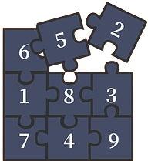
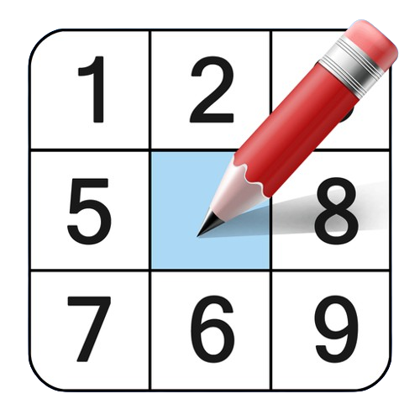
SUD KU BLISS

Slide 2
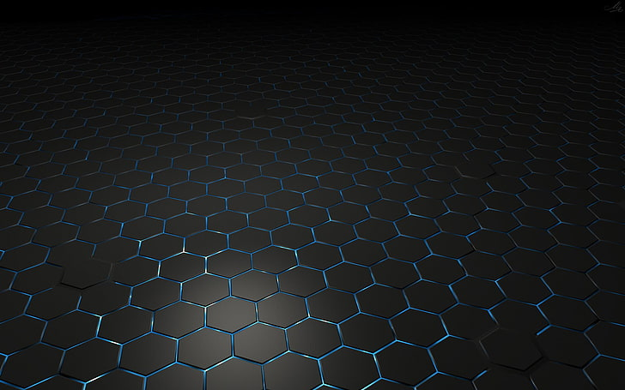

About us
Ananto Nayan Bala 20210204028 Tasmia Hossain 20210204038 Abu Dojana 20210204039

Slide 3
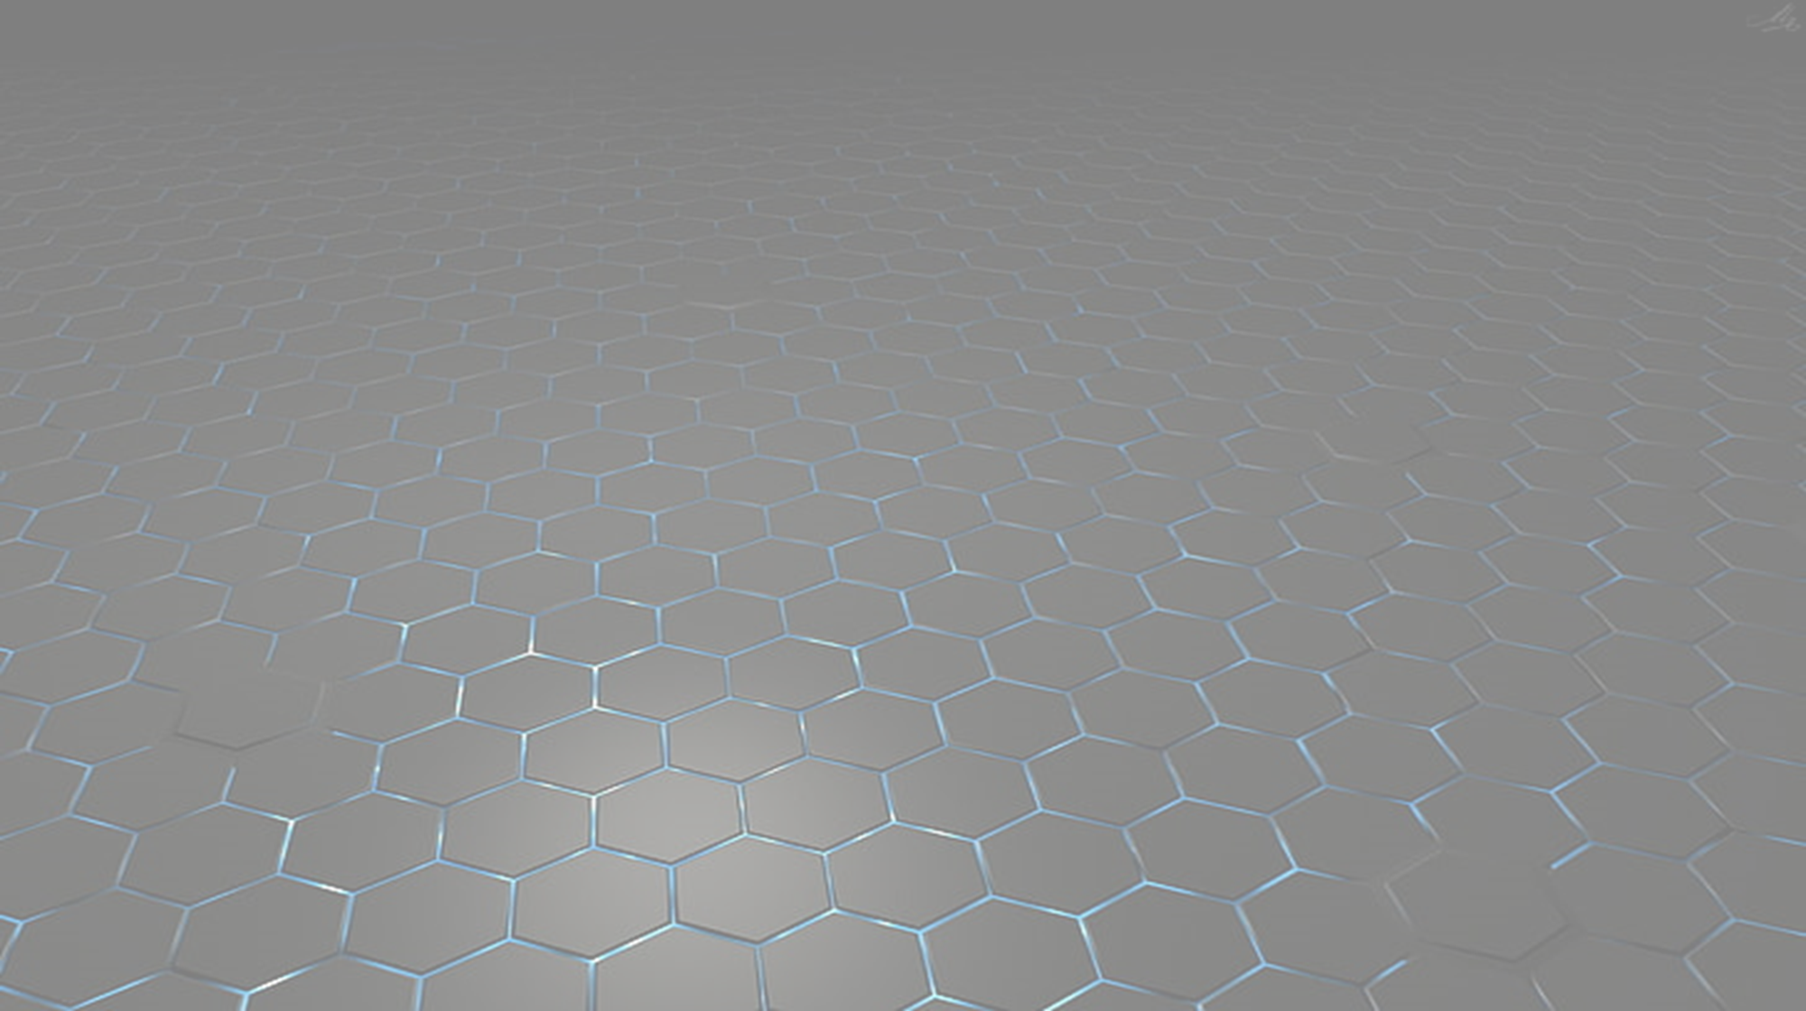
Ideation
Goal: To create an interactive and engaging mobile application that allows users to play Sudoku puzzles of varying difficulty levels
The game logic includes Sudoku-solving algorithms to generate puzzles and validate user inputs

Slide 4

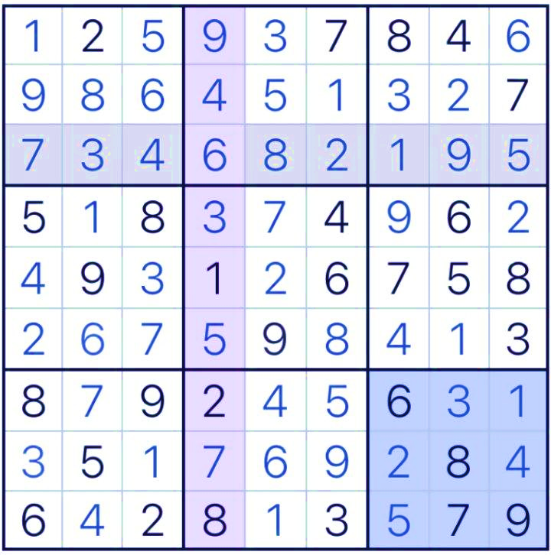
Features
Difficulty Mode
Sudoku Board
Number Input and Clear
Timer
Reveal Option
Save and Resume
Instructions

Slide 5

Technical Structure
Software Platform:
Flutter Framework
Dart Programming Language
Android Studio
Android Emulator
SQLite

Slide 6


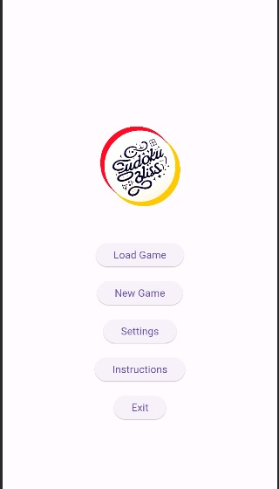
main Menu
Explore the following options in the main menu:
Load Game
New Game
Settings
Instructions
Exit

Slide 7
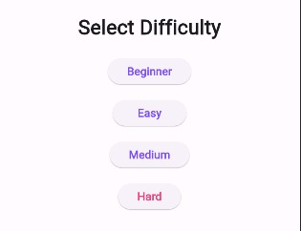
Load game and new game
Load Game - With the 'Load Game' feature, we can resume playing our previously unfinished games
New Game - In the 'New Game' feature, there are four options:
Beginner
Easy
Medium
Hard

Slide 8
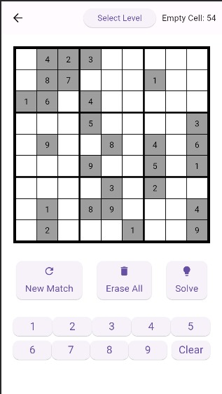
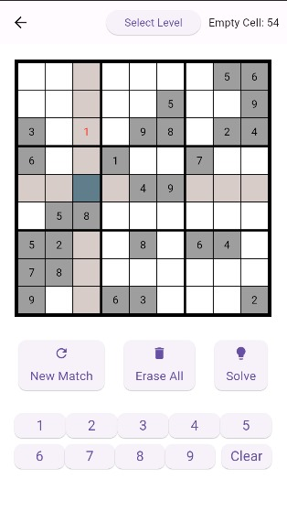
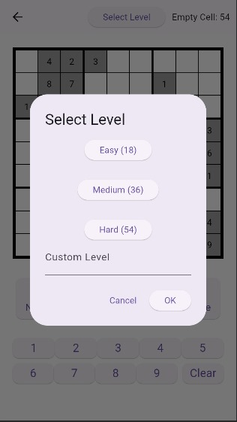
New game- Beginner
In the Beginner mode of the ‘New Game’, one can practice Sudoku without a time counter

Slide 9

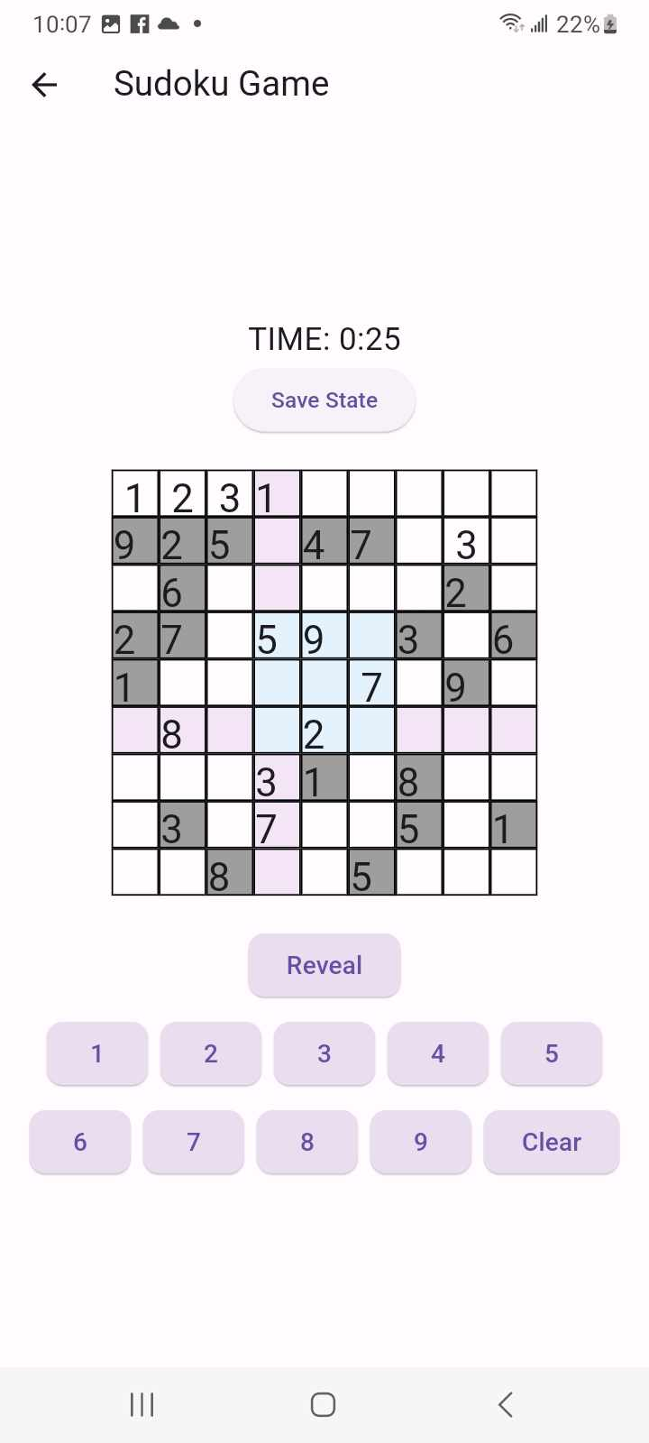
New game- Easy,medium,hard
Easy, Medium and Hard Modes include a timer
Input numbers into cells using dedicated number buttons
Clear button: Remove the value from a selected cell
Reveal button: Fill the selected cell with the correct number

Slide 10
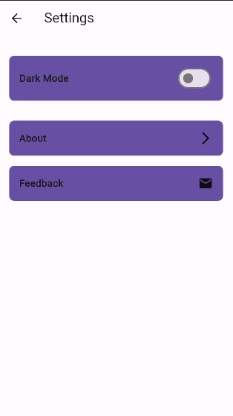
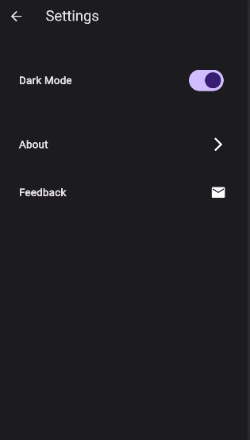
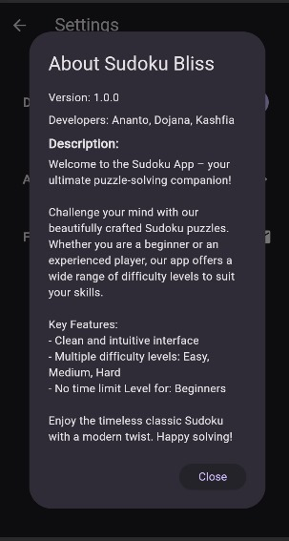
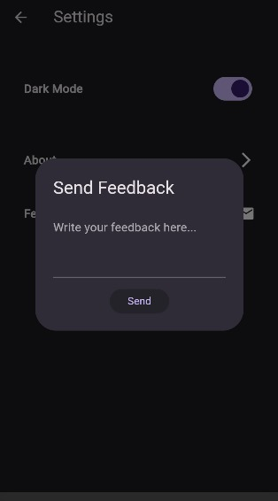
settings
Explore the following options within the settings:
Dark Mode: Enhance your gaming experience with a dark-themed interface
About: Discover information about the developers and gain insights into Sudoku
Feedback: Directly communicate with the developers by providing feedback, which will be sent via email to the entire development team

Slide 11

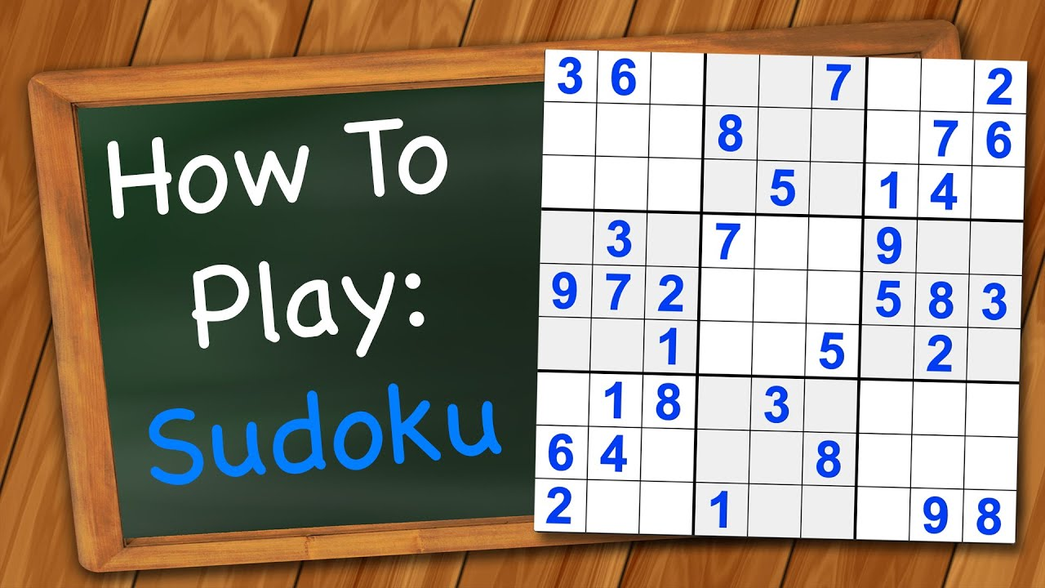
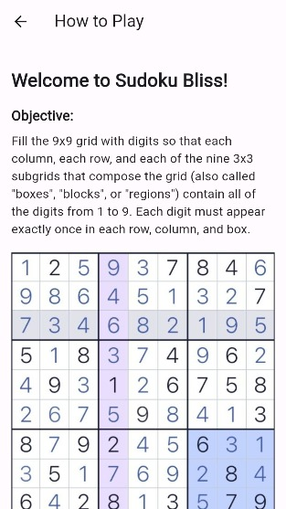
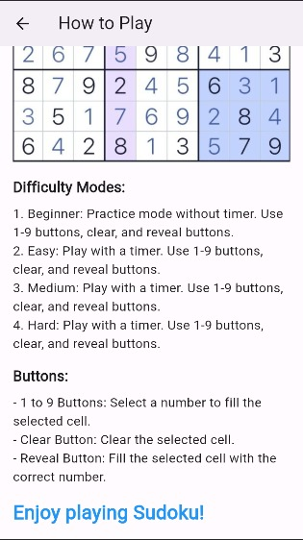
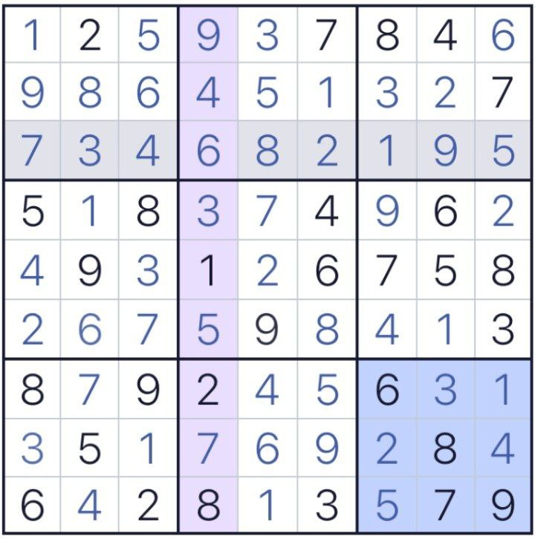
instructions
Access this section if you need guidance on how to play Sudoku

Slide 12




